Slide 1
Unit-II
Mathematical foundation of Big Data
Introduction to Probability Theory

Slide 2
Syllabus
Probability: Random Variables and Joint Probability, Conditional Probability and concept of Markov
chains, Tail bounds, Markov chains and random walks, Pair-wise independence and universal hashing,
Approximate counting, Approximate median. Data Streaming Models and Statistical Methods:
Flajolet Martin algorithm, Distance Sampling and Random Projections, Bloom filters, Mode, Variance,
standard deviation, Correlation analysis and Analysis of Variance.

Slide 3
Probability:
Random Variables and Joint Probability, Conditional Probability and concept of Markov
chains, Tail bounds, Markov chains and random walks, Pair-wise independence and universal hashing,

Slide 4
Concerns
Future: what is the likelihood that a student will get a CS job given his grades?
Current: what is the likelihood that a person has cancer given his symptoms?
Past: what is the likelihood that Marilyn Monroe committed suicide?
Combining evidence.
Always: Representation & Inference

Slide 5
Basic Idea
Attach degrees of belief to proposition.
Theorem: Probability theory is the best way to do this.
  if someone does it differently you can play a game with him and win his money.
Unlike logic, probability theory is non-monotonic.
Additional evidence can lower or raise belief in a proposition.

Slide 6
Probability Models:
Basic Questions
What are they?
  Analogous to constraint models, with probabilities on each table entry
How can we use them to make inferences?
  Probability theory
How does new evidence change inferences
  Non-monotonic problem solved
How can we acquire them?
  Experts for model structure, hill-climbing for parameters

Slide 7
Discrete Probability Model
Set of RandomVariables V1,V2,…Vn
Each RV has a discrete set of values
Joint probability known or computable
For all vi in domain(Vi), Prob(V1=v1,V2=v2,..Vn=vn) is known, non-negative, and sums to 1.

Slide 8
Random Variable
Intuition: A variable whose values belongs to a known set of values, the domain.
Math: non-negative function on a domain (called the sample space) whose sum is 1.
Boolean RV: John has a cavity.
  cavity domain ={true,false}
Discrete RV: Weather Condition
  wc domain= {snowy, rainy, cloudy, sunny}.
Continuous RV: John’s height
  john’s height domain = { positive real number}

Slide 9
Cross-Product Random Variable
If X is RV with values x1,..xn and
  Y is RV with values y1,..ym, then
  Z = X x Y is a RV with n*m values <x1,y1>…<xn,ym>
This will be very useful!
This does not mean P(X,Y) = P(X)*P(Y).

Slide 10
Discrete Probability Distribution
If a discrete RV X has values v1,…vn, then a prob distribution for X is non-negative real valued function p such that: sum p(vi) = 1.
This is just a (normalized) histogram.
Example: a coin is flipped 10 times and heads occur 6 times.
What is best probability model to predict this result?
Biased coin model: prob head = .6, trials = 10

Slide 11
Continuous Probability
RV X has values in R, then a prob distribution for X is a non-negative real-valued function p such that the integral of p over R is 1. (called prob density function)
Standard distributions are uniform, normal or gaussian, poisson, etc.
May resort to empirical if can’t compute analytically. I.E. Use histogram.

Slide 12
Joint Probability: full knowledge
If X and Y are discrete RVs, then the prob distribution for X x Y is called the joint prob distribution.
Let x be in domain of X, y in domain of Y.
If P(X=x,Y=y) = P(X=x)*P(Y=y) for every x and y, then X and Y are independent.
Standard Shorthand: P(X,Y)=P(X)*P(Y), which means exactly the statement above.

Slide 13
Marginalization
Given the joint probability for X and Y, you can compute everything.
Joint probability to individual probabilities.
P(X =x) is sum P(X=x and Y=y) over all y
Conditioning is similar:
  P(X=x) = sum P(X=x|Y=y)*P(Y=y)

Slide 14
Marginalization Example
Compute Prob(X is healthy) from
P(X healthy & X tests positive) = .1
P(X healthy & X tests neg) = .8
P(X healthy) = .1 + .8 = .9
P(flush) = P(heart flush)+P(spade flush)+
P(diamond flush)+ P(club flush)

Slide 15
Conditional Probability
P(X=x | Y=y) = P(X=x, Y=y)/P(Y=y).
Intuition: use simple examples
1 card hand X = value card, Y = suit card
P( X= ace | Y= heart) = 1/13
also P( X=ace , Y=heart) = 1/52
P(Y=heart) = 1 / 4
P( X=ace, Y= heart)/P(Y =heart) = 1/13.

Slide 16
Formula
Shorthand: P(X|Y) = P(X,Y)/P(Y).
Product Rule: P(X,Y) = P(X |Y) * P(Y)
Bayes Rule:
  P(X|Y) = P(Y|X) *P(X)/P(Y).
Remember the abbreviations.

Slide 17
Conditional Example
P(A = 0) = .7
P(A = 1) = .3
P(A,B) = P(B,A)
P(B,A)= P(B|A)*P(A)
P(A,B) = P(A|B)*P(B)
P(A|B) = P(B|A)*P(A)/P(B)
B | A | P(B|A)
0 | 0 | .2
0 | 1 | .9
1 | 0 | .8
1 | 1 | .1

Slide 18
Solving
Given prob for A and prob for B given A
First, choose value for A, according to prob
Now use conditional table to choose value for B with correct probability.
That constructs one world.
Repeats lots of times and count number of times A= 0 & B = 0, A=0 & B= 1, etc.
Turn counts into probabilities.

Slide 19
Consequences of Bayes Rules
P(X|Y,Z) = P(Y,Z |X)*P(X)/P(Y,Z).
proof: Treat Y&Z as new product RV U
P(X|U) =P(U|X)*P(X)/P(U) by bayes
P(X1,X2,X3) =P(X3|X1,X2)*P(X1,X2)
  = P(X3|X1,X2)*P(X2|X1)*P(X1) or
P(X1,X2,X3) =P(X1)*P(X2|X1)*P(X3|X1,X2).
Note: These equations make no assumptions!
Last equation is called the Chain or Product Rule
Can pick the any ordering of variables.

Slide 20
Extensions of P(A) +P(~A) = 1
P(X|Y) + P(~X|Y) = 1
Semantic Argument
  conditional just restricts worlds
Syntactic Argument: lhs equals
  P(X,Y)/P(Y) + P(~X,Y)/P(Y) =
  (P(X,Y) + P(~X,Y))/P(Y) = (marginalization)
  P(Y)/P(Y) = 1.

Slide 21
Bayes Rule Example
Meningitis causes stiff neck (.5).
  P(s|m) = 0.5
Prior prob of meningitis = 1/50,000.
  p(m)= 1/50,000 = .00002
Prior prob of stick neck ( 1/20).
  p(s) = 1/20.
Does patient have meningitis?
  p(m|s) = p(s|m)*p(m)/p(s) = 0.0002.
Is this reasonable? p(s|m)/p(s) = change=10

Slide 22
Bayes Rule: multiple symptoms
Given symptoms s1,s2,..sn, what estimate probability of Disease D.
P(D|s1,s2…sn) = P(D,s1,..sn)/P(s1,s2..sn).
If each symptom is boolean, need tables of size 2^n. ex. breast cancer data has 73 features per patient. 2^73 is too big.
Approximate!

Slide 23
Notation: max arg
Conceptual definition, not operational
Max arg f(x) is a value of x that maximizes f(x).
MaxArg Prob(X = 6 heads | prob heads)
yields prob(heads) = .6

Slide 24
Markova Process

Slide 25
What is “Discrete Time”?
time
⁰
¹
²
³
⁴
Events occur at a specific points in time

Slide 26









What is “Stochastic Process”?
State Space = {SUNNY,
RAINNY}
Day
^{Day 1}
^{Day 2}
^{Day 3}
^{Day 4}
^{Day 5}
^{Day 6}
^{Day 7}
^{THU}
^{FRI}
^{SAT}
^{SUN}
^{MON}
^{TUE}
^{WED}
X(day_{i}): Status of the weather observed each DAY

Slide 27
Markov Processes
Stochastic Process X(t) is a random variable that varies with time.
A state of the process is a possible value of X(t)
Markov Process
  The future of a process does not depend on its past, only on its present
  a Markov process is a stochastic (random) process in which the probability distribution of the current value is conditionally independent of the series of past value, a characteristic called the Markov property.
  Markov property: the conditional probability distribution of future states of the process, given the present state and all past states, depends only upon the present state and not on any past states
Marko Chain: is a discrete-time stochastic process with the Markov property

Slide 28
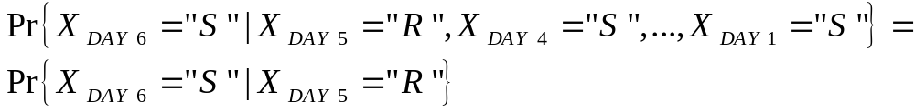
What is “Markov Property”?
PAST EVENTS
NOW
FUTURE EVENTS
?
Probability of “R” in DAY6 given all previous states
Probability of “S” in DAY6 given all previous states
Day
^{Day 1}
^{Day 2}
^{Day 3}
^{Day 4}
^{Day 5}
^{Day 6}
^{Day 7}
^{THU}
^{FRI}
^{SAT}
^{SUN}
^{MON}
^{TUE}
^{WED}
Markov Property: The probability that it will be (FUTURE) SUNNY in DAY 6
given that it is RAINNY in DAY 5 (NOW) is independent from PAST EVENTS

Slide 29
Notation
Discrete time t_{k} or k
Value of the stochastic
process at instant t_{k} or k
X(t_{k}) or X_{k} = x_{k}
The stochastic process at time t_{k} or k

Slide 30
Markov Chain
Discrete Time Markov Chains (DTMC)

Slide 31
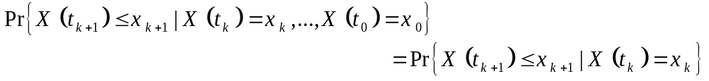
Markov Processes
Markov Process
  The future of a process does not depend on its past, only on its present
Since we are dealing with “chains”, X(ti) = Xi can take discrete values from a finite or a countable infinite set.
The possible values of Xi form a countable set S called the state space of the chain
For a Discrete-Time Markov Chain (DTMC), the notation is also simplified to
Where X_{k} is the value of the state at the kth step

Slide 32
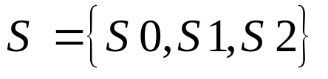
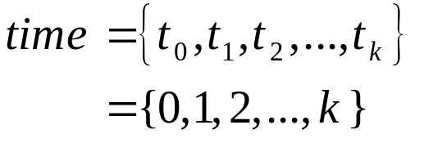
General Model of a Markov Chain
p₁₁
p₀₁
p₁₂
p₂₂
p₀₀
S0
S1
S2
p₁₀
p₂₁
p₂₀
Discrete Time (Slotted Time)
State Space
i
Si
State i
^{or}
p_{ij}
Transition Probability from State Si to State Sj

Slide 33

Example of a Markov Process
A very simple weather model
p_{SR}=0.3
SUNNY
RAINY
p_{RR}=0.4
p_{SS}=0.7
p_{RS}=0.6
State Space
If today is Sunny, What is the probability that to have a SUNNY weather after 1 week?
If today is rainy, what is the probability to stay rainy for 3 days?
Problem: Determine the transition probabilities from one state to another after n events.

Slide 34
Chapman Kolmogorov Equation
Determine transition probabilities from one state to anothe after n events.

Slide 35
Chain Rule and Markov Models
Recall P(X1, X2, …Xn) = P(X1)*P(X2|X1)*…P(Xn| X1,X2,..Xn-1).
If X1, X2, etc are values at time points 1, 2..
and if Xn only depends on k previous times, then this is a markov model of order k.
MMO: Independent of time
  P(X1,…Xn) = P(X1)*P(X2)..*P(Xn)

Slide 36
Markov Models
MM1: depends only on previous time
  P(X1,…Xn)= P(X1)*P(X2|X1)*…P(Xn|Xn-1).
May also be used for approximating probabilities. Much simpler to estimate.
MM2: depends on previous 2 times
  P(X1,X2,..Xn)= P(X1,X2)*P(X3|X1,X2) etc

Slide 37
Common DNA application
Looking for needles: surprising frequency?
Goal:Compute P(gataag) given lots of data
MM0 = P(g)*P(a)*P(t)*P(a)*P(a)*P(g).
MM1 = P(g)*P(a|g)*P(t|a)*P(a|a)*P(g|a).
MM2 = P(ga)*P(t|ga)*P(a|ta)*P(g|aa).
Note: each approximation requires less data and less computation time.

Slide 38
Example of a Markov Process
A very simple weather model
p_{SR}=0.3
SUNNY
RAINY
p_{RR}=0.4
p_{SS}=0.7
p_{RS}=0.6
State Space
If today is Sunny, What is the probability that to have a SUNNY weather after 1 week?
If today is rainy, what is the probability to stay rainy for 3 days?
Problem: Determine the transition probabilities from one state to another after n events.

Slide 39
Chapman Kolmogorov Equation
Determine transition probabilities from one state to anothe after n events.

Slide 40

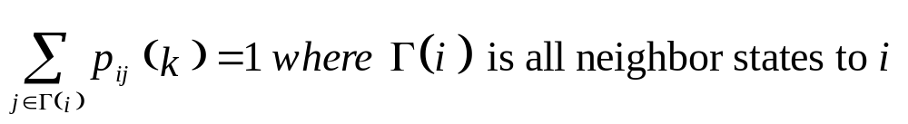
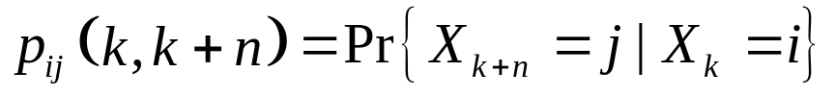
Chapman-Kolmogorov Equations
We define the one-step transition probabilities at the instant k as
Necessary Condition: for all states i, instants k, and all feasible transitions from state i we have:
We define the n-step transition probabilities from instant k to k+n as
x₁
x_{i}
…
x_{j}
x_{R}
Discrete time
k
k+1
u
k+n

Slide 41


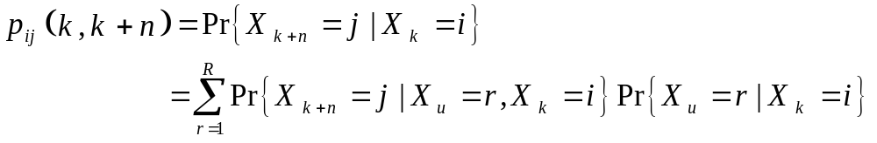
Chapman-Kolmogorov Equations
Using Law of Total Probability
x₁
x_{i}
…
x_{j}
x_{R}
Discrete time
k
k+1
u
k+n

Slide 42
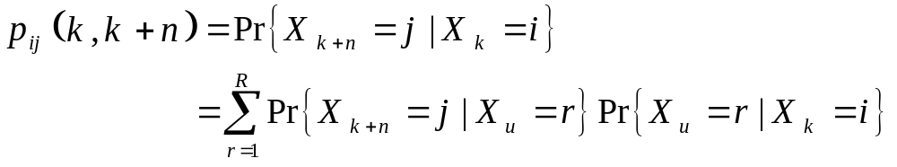
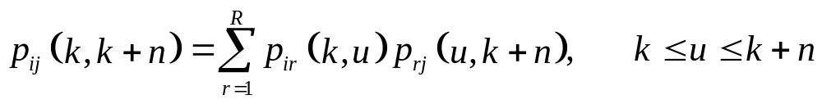
Chapman-Kolmogorov Equations
Using the memoryless property of Markov chains
Therefore, we obtain the Chapman-Kolmogorov Equation

Slide 43
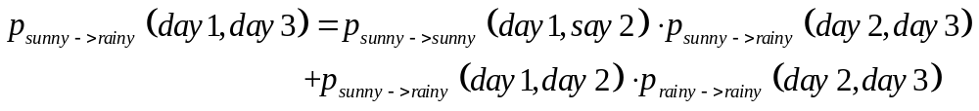
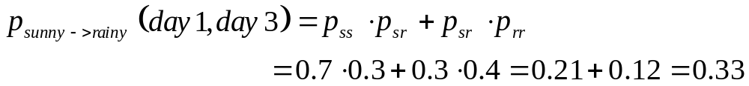
Chapman-Kolmogorov Equations
Example on the simple weather model
p_{SR}=0.3
p_{SS}=0.7
SUNNY
RAINY
p_{RR}=0.4
p_{RS}=0.6
What is the probability that the weather is rainy on day 3 knowing that it is sunny on day 1?

Slide 44
Transition Matrix
Generalization Chapman-Kolmogorov Equations

Slide 45
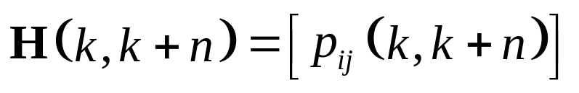
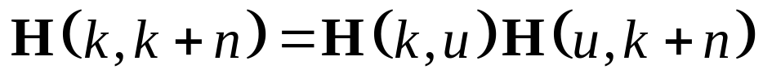
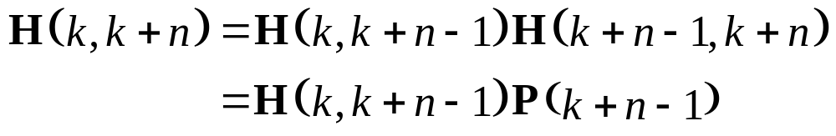
Transition Matrix
Simplify the transition probability representation
Define the n-step transition matrix as
We can re-write the Chapman-Kolmogorov Equation as follows:
Choose, u = k+n-1, then
Forward
Chapman-Kolmogorov
One step transition probability

Slide 46
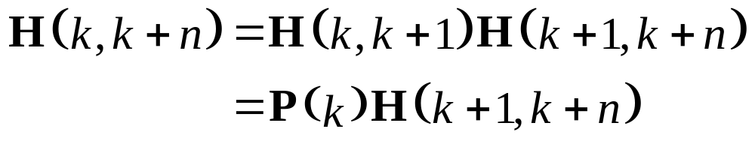
Transition Matrix
Simplify the transition probability representation
Choose, u = k+1, then
Backward
Chapman-Kolmogorov
One step transition probability

Slide 47
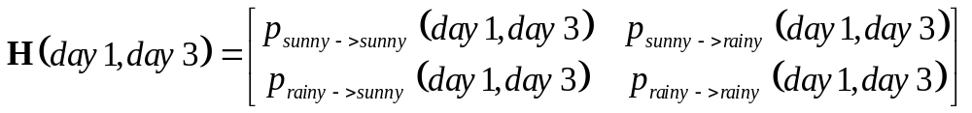
Transition Matrix
Example on the simple weather model
p_{SR}=0.3
p_{SS}=0.7
SUNNY
RAINY
p_{RR}=0.4
p_{RS}=0.6
What is the probability that the weather is rainy on day 3 knowing that it is sunny on day 1?

Slide 48

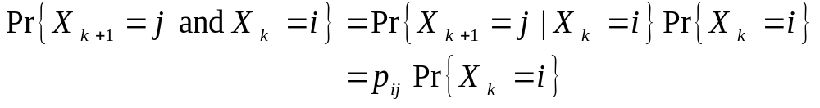
Homogeneous Markov Chains
Markov chains with time-homogeneous transition probabilities
Time-homogeneous Markov chains (or, Markov chains with time-homogeneous transition probabilities) are processes where
The one-step transition probabilities are independent of time k.
is said to be Stationary Transition Probability
Even though the one step transition is independent of k, this does not mean that the joint probability of X_{k+1} and X_{k} is also independent of k. Observe that:

Slide 49
Random Walks on Undirected graphs
Lemma: A random walk on an undirected graph G is aperiodic iff G is not bipartite.
Pf: A graph is bipartite iff it does not have odd cycle.
In an undirected graph, there is always a path of length 2 from a vertex to itself.

Slide 50
Thus, if the graph is bipartite then the random walk is periodic (d=2).
If not bipartite, then it has an odd cycle and GCD(2,odd-number)=1.
Thus, the Markov chain is aperiodic.

Slide 51

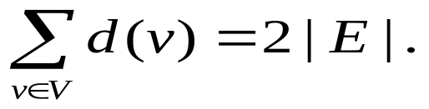
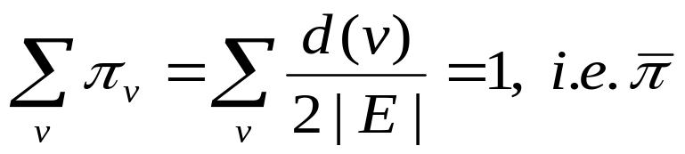
Thm: G: not bipartite, finite, undirected and connected. A random walk on G converges to a stationary distribution , where π_{v}=d(v)/2|E|.
Pf:
Thus, is a distribution.
Let P be the transition probability matrix.
Let N(v) be the neighbors of v.

Slide 52
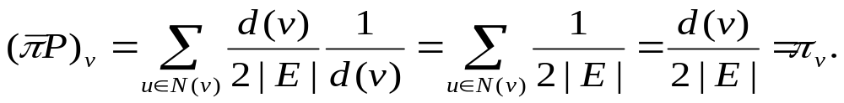

Thus,
Cor: h_{v,u}: the expected number of steps to reach u from v. For any u∈G, h_{u,u}=2|E|/d(u).

Slide 53
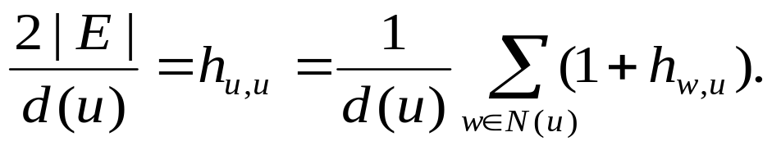
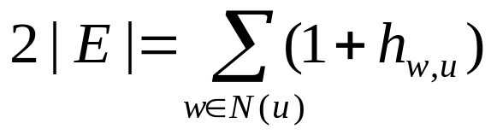
Lemma: If (u,v)∈E, then h_{v,u} ≤ 2|E|.
Pf:
N(u): the set of neighbors of u.
Thus,
⇒ h_{v,u}<2|E|.

Slide 54
Def: The cover time of a graph G=(V,E) is the maximum over all v∈V of the expected time to visit all of the nodes in the graph by a random walk starting from v.
Lemma: The cover time of G=(V,E) is bounded by 4|V||E|.

Slide 55
Pf: Choose a spanning tree of G. Then there exists a cyclic tour on this tree, where each edge is traversed once in each direction, which can be found by doing a DFS.
Let v₀,v₁,…,v_{2|V|-2}=v₀ be the sequence of vertices in the tour, starting from v₀.

Slide 56
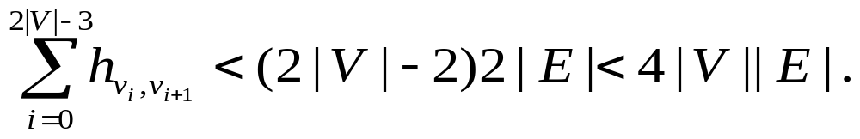
Clearly, the expected time to go through the vertices in the tour is an upper bound on the cover time.
Hence, the cover time is bounded above by

Slide 57
Application: s-t connectivity
It can be done with BFS, DFS by using Ω(n) space.
The following randomized algorithm works with only O(logn) bits.
s-t Connectivity Algorithm:
Input: G
Start a random walk from s.
If the walk reaches t within 4n³ steps, return that there is a path. Otherwise, return no path.

Slide 58
Hashing

Slide 59
Reminder: Dictionary ADT
Dictionary operations
  insert
  find
  delete
  create
  destroy
Stores values associated with user-specified keys
  values may be any (homogeneous) type
  keys may be any (homogeneous) comparable type
Adrien
  Roller-blade demon
Hannah
  C++ guru
Dave
  Older than dirt
…
insert
Donald
l33t haxtor
Adrien
Roller-blade demon
find(Adrien)
Hashing
CSE 326 Autumn 2001 <number>

Slide 60
Dictionary Implementations So Far
 | Insert | Find | Delete
Unsorted list | O(1) | O(n) | O(n)
Trees | O(log n) | O(log n) | O(log n)
Sorted array | O(n) | O(log n) | O(n)
Array special case known keys ∈ {1, … , K} | O(1) | O(1) | O(1)
Hashing
CSE 326 Autumn 2001 <number>

Slide 61
ADT Legalities:
A Digression on Keys
Methods are the contract between an ADT and the outside agent (client code)
  Ex: Dictionary contract is {insert, find, delete}
  Ex: Priority Q contract is {insert, deleteMin}
Keys are the currency used in transactions between an outside agent and ADT
  Ex: insert(key), find(key), delete(key)
So …
  How about O(1) insert/find/delete for any key type?
Hashing
CSE 326 Autumn 2001 <number>

Slide 62
Hash Table Goal:
Key as Index
We can access a record as a[5]
We want to access a record as a[“Hannah”]
2
Adrien
  roller-blade demon
Adrien
Adrien
  roller-blade demon
5
Hannah
  C++ guru
Hannah
Hannah
  C++ guru
Hashing
CSE 326 Autumn 2001 <number>

Slide 63
Hash Table Approach
Hannah
f(x)
Dave
Adrien
Donald
Ed
But… is there a problem with this pipe-dream?
Hashing
CSE 326 Autumn 2001 <number>

Slide 64
Hash Table
Dictionary Data Structure
Hash function: maps keys to integers
  Result:
    Can quickly find the right spot for a given entry
Unordered and sparse table
  Result:
    Cannot efficiently list all entries
    Cannot efficiently find min, max, ordered ranges
Hannah
f(x)
Dave
Adrien
Donald
Ed
Hashing
CSE 326 Autumn 2001 <number>

Slide 65
Hash Table Taxonomy
hash function
Hannah
f(x)
Dave
Adrien
collision
Donald
Ed
keys
load factor λ = ^{# of entries in table}
_{tableSize}
Hashing
CSE 326 Autumn 2001 <number>

Slide 66
Agenda:
Hash Table Design Decisions
What should the hash function be?
What should the table size be?
How should we resolve collisions?
Hashing
CSE 326 Autumn 2001 <number>

Slide 67
Hash Function
Hash function maps a key to a table index
Value & find(Key & key) {
int index = hash(key) % tableSize;
return Table[index];
}
Hashing
CSE 326 Autumn 2001 <number>

Slide 68
What Makes A Good Hash Function?
Fast runtime
  O(1) and fast in practical terms
Distributes the data evenly
  hash(a) % size ≠ hash(b) % size
Uses the whole hash table
  for all 0 ≤ i < size, ∃ k such that hash(k) % size = i
Hashing
CSE 326 Autumn 2001 <number>

Slide 69
Good Hash Function for
Integer Keys
Choose
  tableSize is prime
  hash(n) = n
Example:
  tableSize = 7
  insert(4)
  insert(17)
  find(12)
  insert(9)
  delete(17)
0
1
2
3
4
5
6
Hashing
CSE 326 Autumn 2001 <number>

Slide 70
Good Hash Function for Strings?
Let s = s₁s₂s₃s₄…s_{n}: choose
  hash(s) = s₁ + s₂128 + s₃128² + s₄128³ + … + s_{n}128^{n}
  Think of the string as a base 128 (aka radix 128) number
Problems:
  hash(“really, really big”) = well… something really, really big
  hash(“one thing”) % 128 = hash(“other thing”) % 128
Hashing
CSE 326 Autumn 2001 <number>

Slide 71
String Hashing
Issues and Techniques
Minimize collisions
  Make tableSize and radix relatively prime
    Typically, make tableSize not a multiple of 128
Simplify computation
  Use Horner’s Rule
int hash(String s) {
h = 0;
for (i = s.length() - 1; i >= 0; i--) {
h = (s[i] + 128*h) % tableSize;
}
return h;
}
Hashing
CSE 326 Autumn 2001 <number>

Slide 72
Good Hashing:
Multiplication Method
Hash function is defined by size plus a parameter A
  h_{A}(k) = ⎣size * (k*A mod 1)⎦ where 0 < A < 1
Example: size = 10, A = 0.485
  h_{A}(50) = ⎣10 * (50*0.485 mod 1)⎦
  = ⎣10 * (24.25 mod 1)⎦ = ⎣10 * 0.25⎦ = 2
  no restriction on size!
  when building a static table, we can try several values of A
  more computationally intensive than a single mod
Hashing
CSE 326 Autumn 2001 <number>

Slide 73
Hashing Dilemma
Suppose your Worst Enemy 1) knows your hash function; 2) gets to decide which keys to send you?
Faced with this enticing possibility, Worst Enemy decides to:
  Send you keys which maximize collisions for your hash function.
  Take a nap.
Moral: No single hash function can protect you!
Faced with this dilemma, you:
  Give up and use a linked list for your Dictionary.
  Drop out of software, and choose a career in fast foods.
  Run and hide.
  Proceed to the next slide, in hope of a better alternative.
Hashing
CSE 326 Autumn 2001 <number>

Slide 74
Universal Hashing¹
Suppose we have a set K of possible keys, and a finite set H of hash functions that map keys to entries in a hashtable of size m.
0
k₁
1
h
.
.
.
K
k₂
m-1
h_{i}
H
h_{j}
Definition:
H is a universal collection of hash functions if and only if …
  For any two keys k₁, k₂ in K, there are at most |H|/m functions in H for which h(k₁) = h(k₂).
So … if we randomly choose a hash function from H, our chances of collision are no more than if we get to choose hash table entries at random!
¹Motivation: see previous slide (or visit http://www.burgerking.com/jobs)
Hashing
CSE 326 Autumn 2001 <number>

Slide 75
Random Hashing – Not!
How can we “randomly choose a hash function”?
  Certainly we cannot randomly choose hash functions at runtime, interspersed amongst the inserts, finds, deletes! Why not?
We can, however, randomly choose a hash function each time we initialize a new hashtable.
Conclusions
  Worst Enemy never knows which hash function we will choose – neither do we!
  No single input (set of keys) can always evoke worst-case behavior
Hashing
CSE 326 Autumn 2001 <number>

Slide 76
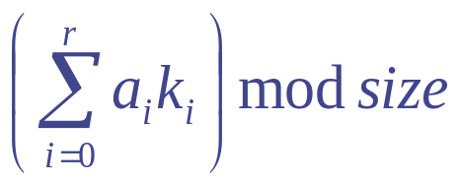
Good Hashing:
Universal Hash Function A (UHF_{a})
Parameterized by prime table size and vector:
  a = <a₀ a₁ … a_{r}> where 0 <= a_{i} < size
Represent each key as r + 1 integers where k_{i} < size
  size = 11, key = 39752 ==> <3,9,7,5,2>
  size = 29, key = “hello world” ==> <8,5,12,12,15,23,15,18,12,4>
  h_{a}(k) =
Hashing
CSE 326 Autumn 2001 <number>

Slide 77
UHF_{a}: Example
Context: hash strings of length 3 in a table of size 131
  let a = <35, 100, 21>
  h_{a}(“xyz”) = (35*120 + 100*121 + 21*122) % 131
  = 129
Hashing
CSE 326 Autumn 2001 <number>

Slide 78
Thinking about UHF_{a}
Strengths:
  works on any type as long as you can form k_{i}’s
  if we’re building a static table, we can try many values of the hash vector <a>
  random <a> has guaranteed good properties no matter what we’re hashing
Weaknesses
  must choose prime table size larger than any k_{i}
Hashing
CSE 326 Autumn 2001 <number>

Slide 79
Good Hashing:
Universal Hash Function 2 (UHF₂)
Parameterized by j, a, and b:
  j * size should fit into an int
  a and b must be less than size
  h_{j,a,b}(k) = ((ak + b) mod (j*size))/j
Hashing
CSE 326 Autumn 2001 <number>
Notes:
Here is an alternative universal hash function.
Note that, like the other one, this is parameterized.
The key to these universal functions is that we can fiddle with the parameters to get a new (good) hash function. That means that in some sense there are no bad input cases for these (they’re not always bad).
This one is based on pseudo-random number generation. Essentially, it does what your computer does when calculating the next “random” number in a sequence.

Slide 80
UHF₂ : Example
Context: hash integers in a table of size 16
let j = 32, a = 100, b = 200
h_{j,a,b}(1000) = ((100*1000 + 200) % (32*16)) / 32
= (100200 % 512) / 32
= 360 / 32
= 11
Hashing
CSE 326 Autumn 2001 <number>

Slide 81
Thinking about UHF₂
Strengths
  if we’re building a static table, we can try many parameter values
  random a,b has guaranteed good properties no matter what we’re hashing
  can choose any size table
  very efficient if j and size are powers of 2 (why?)
Weaknesses
  need to turn non-integer keys into integers
Hashing
CSE 326 Autumn 2001 <number>
Notes:
We’ll see later that we can actually do even better than this with universal hashing. We can “adapt” to input as we go!

Slide 82
Hash Function Summary
Goals of a hash function
  reproducible mapping from key to table index
  evenly distribute keys across the table
  separate commonly occurring keys (neighboring keys?)
  fast runtime
Some hash function candidates
  h(n) = n % size
  h(n) = string as base 128 number % size
  Multiplication hash: compute percentage through the table
  Universal hash function A: dot product with random vector
  Universal hash function 2: next pseudo-random number
Hashing
CSE 326 Autumn 2001 <number>
Notes:
The idea of neighboring keys here may change from application to application.
In one context, neighboring keys may be those with the same last characters or first characters…
say, when hashing names in a school system. Many people may have the same last names or first names (but few will have the same of both).

Slide 83
Tail Bounds
Flajolet Martin Algorithm
Streaming Model

Slide 84
Processing Data Streams: Motivation
A growing number of applications generate streams of data
  Performance measurements in network monitoring and traffic management
  Call detail records in telecommunications
  Transactions in retail chains, ATM operations in banks
  Log records generated by Web Servers
  Sensor network data
Application characteristics
  Massive volumes of data (several terabytes)
  Records arrive at a rapid rate
Goal: Mine patterns, process queries and compute statistics on data streams in real-time

Slide 85
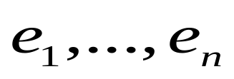
Data Streams: Computation Model
A data stream is a (massive) sequence of elements:
Stream processing requirements
  Single pass: Each record is examined at most once
  Bounded storage: Limited Memory (M) for storing synopsis
  Real-time: Per record processing time (to maintain synopsis) must be low
Synopsis in Memory
Data Streams
Stream
Processing
Engine
(Approximate)
Answer

Slide 86


Data Stream Processing Algorithms
Generally, algorithms compute approximate answers
  Difficult to compute answers accurately with limited memory
Approximate answers - Deterministic bounds
  Algorithms only compute an approximate answer, but bounds on error
Approximate answers - Probabilistic bounds
  Algorithms compute an approximate answer with high probability
    With probability at least , the computed answer is within a factor of the actual answer
Single-pass algorithms for processing streams also applicable to (massive) terabyte databases!

Slide 87
Sampling: Basics
Idea: A small random sample S of the data often well-represents all the data
  For a fast approx answer, apply “modified” query to S
  Example: select agg from R where R.e is odd
  (n=12)
  If agg is avg, return average of odd elements in S
  If agg is count, return average over all elements e in S of
    n if e is odd
    0 if e is even
Data stream: 9 3 5 2 7 1 6 5 8 4 9 1
Sample S: 9 5 1 8
answer: 5
answer: 12*3/4 =9
Unbiased: For expressions involving count, sum, avg: the estimator
is unbiased, i.e., the expected value of the answer is the actual answer

Slide 88
Probabilistic Guarantees
Example: Actual answer is within 5 ± 1 with prob ≥ 0.9
Use Tail Inequalities to give probabilistic bounds on returned answer
  Markov Inequality
  Chebyshev’s Inequality
  Hoeffding’s Inequality
  Chernoff Bound

Slide 89



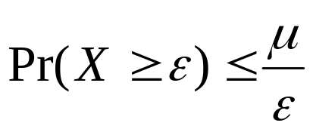
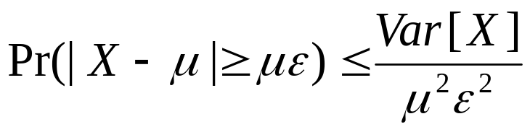
Tail Inequalities
Probability
distribution
General bounds on tail probability of a random variable (that is, probability that a random variable deviates far from its expectation)
Basic Inequalities: Let X be a random variable with expectation and variance Var[X]. Then for any
Tail probability
Markov:
Chebyshev:

Slide 90
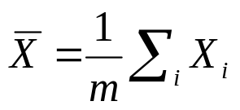

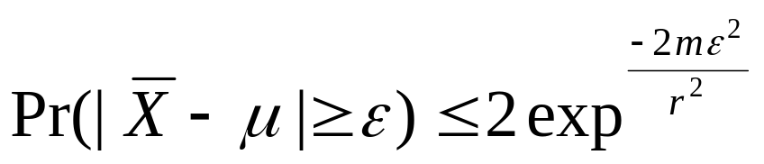
Tail Inequalities for Sums
Possible to derive stronger bounds on tail probabilities for the sum of independent random variables
Hoeffding’s Inequality: Let X1, ..., Xm be independent random variables with 0<=Xi <= r. Let and be the expectation of . Then, for any
Application to avg queries:
  m is size of subset of sample S satisfying predicate (3 in example)
  r is range of element values in sample (8 in example)

Slide 91



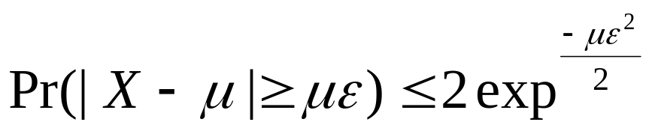
Tail Inequalities for Sums (Contd.)
Possible to derive even stronger bounds on tail probabilities for the sum of independent Bernoulli trials
Chernoff Bound: Let X1, ..., Xm be independent Bernoulli trials such that Pr[Xi=1] = p (Pr[Xi=0] = 1-p). Let and be the expectation of . Then, for any ,
Application to count queries:
  m is size of sample S (4 in example)
  p is fraction of odd elements in stream (2/3 in example)
Remark: Chernoff bound results in tighter bounds for count queries compared to Hoeffding’s inequality

Slide 92
Computing Stream Sample
Reservoir Sampling [Vit85]: Maintains a sample S of a fixed-size M
  Add each new element to S with probability M/n, where n is the current number of stream elements
  If add an element, evict a random element from S
  Instead of flipping a coin for each element, determine the number of elements to skip before the next to be added to S
Concise sampling [GM98]: Duplicates in sample S stored as <value, count> pairs (thus, potentially boosting actual sample size)
  Add each new element to S with probability 1/T (simply increment count if element already in S)
  If sample size exceeds M
    Select new threshold T’ > T
    Evict each element (decrement count) from S with probability 1-T/T’
  Add subsequent elements to S with probability 1/T’

Slide 93
Streaming Model: Special Cases
Time-Series Model
  Only j-th update updates A[j] (i.e., A[j] := c[j])
Cash-Register Model
  c[j] is always >= 0 (i.e., increment-only)
  Typically, c[j]=1, so we see a multi-set of items in one pass
Turnstile Model
  Most general streaming model
  c[j] can be >0 or <0 (i.e., increment or decrement)
Problem difficulty varies depending on the model
  E.g., MIN/MAX in Time-Series vs. Turnstile!

Slide 94
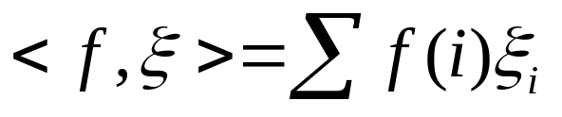


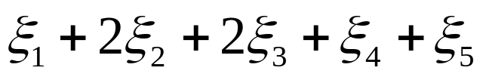
Linear-Projection (aka AMS) Sketch Synopses
Goal: Build small-space summary for distribution vector f(i) (i=1,..., N) seen as a stream of i-values
Basic Construct: Randomized Linear Projection of f() = project onto inner/dot product of f-vector
  Simple to compute over the stream: Add whenever the i-th value is seen
  Generate ‘s in small (logN) space using pseudo-random generators
  Tunable probabilistic guarantees on approximation error
  Delete-Proof: Just subtract to delete an i-th value occurrence
  Composable: Simply add independently-built projections
2
2
1
1
1
Data stream: 3, 1, 2, 4, 2, 3, 5, . . .
f(1) f(2) f(3) f(4) f(5)
where = vector of random values from an appropriate distribution
Data stream: 3, 1, 2, 4, 2, 3, 5, . . .

Slide 95


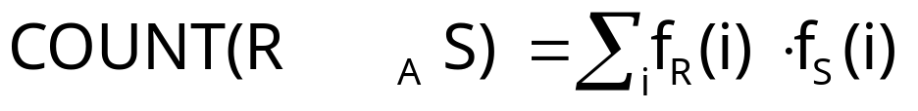
Example: Binary-Join COUNT Query
Problem: Compute answer for the query COUNT(R _{A} S)
Example:
3
2
Data stream R.A: 4 1 2 4 1 4
1
0
1
2
3
4
2
2
Data stream S.A: 3 1 2 4 2 4
1
1
1
2
3
4
= 10 (2 + 2 + 0 + 6)
Exact solution: too expensive, requires O(N) space!
  N = sizeof(domain(A))

Slide 96


Basic AMS Sketching Technique [AMS96]
Key Intuition: Use randomized linear projections of f() to define random variable X such that
  X is easily computed over the stream (in small space)
  E[X] = COUNT(R _{A} S)
  Var[X] is small
Basic Idea:
  Define a family of 4-wise independent {-1, +1} random variables
  Pr[ = +1] = Pr[ = -1] = 1/2
    Expected value of each , E[ ] = 0
  Variables are 4-wise independent
    Expected value of product of 4 distinct = 0
  Variables can be generated using pseudo-random generator using only O(log N) space (for seeding)!
Probabilistic error guarantees
(e.g., actual answer is 10±1 with
probability 0.9)

Slide 97
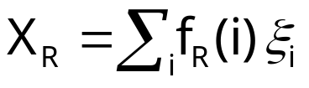
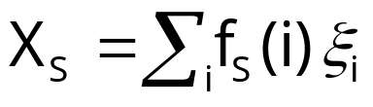




AMS Sketch Construction
Compute random variables: and
  Simply add to X_{R}(X_{S}) whenever the i-th value is observed in the R.A (S.A) stream
Define X = X_{R}X_{S} to be estimate of COUNT query
Example:
3
2
Data stream R.A: 4 1 2 4 1 4
1
0
1
2
3
4
2
2
Data stream S.A: 3 1 2 4 2 4
1
1
1
2
3
4

Slide 98

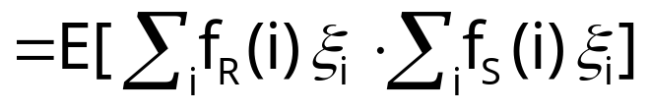
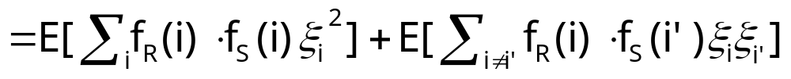
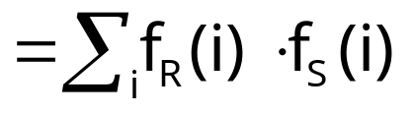


Binary-Join AMS Sketching Analysis
Expected value of X = COUNT(R _{A} S)
Using 4-wise independence, possible to show that
is self-join size of R (second/L2 moment)
1
0

Slide 99
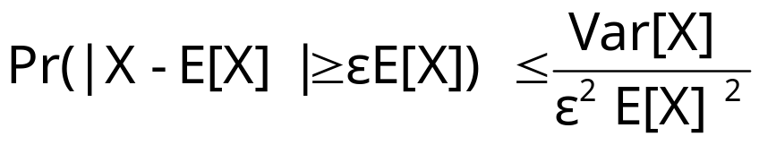

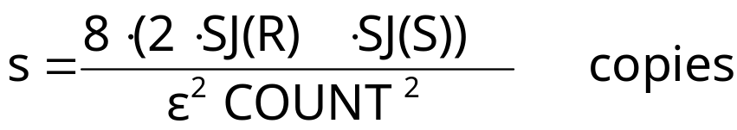

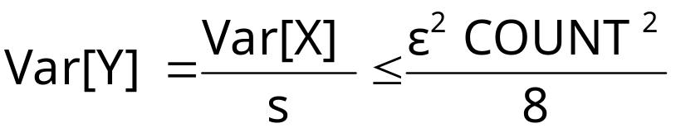
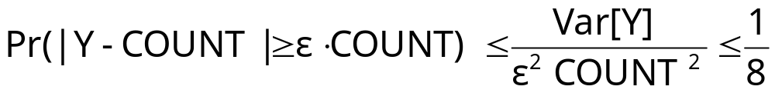
Boosting Accuracy
Chebyshev’s Inequality:
Boost accuracy to by averaging over several independent copies of X (reduces variance)
By Chebyshev:
x
x
x
Average
y

Slide 100










Boosting Confidence
Boost confidence to by taking median of 2log(1/ ) independent copies of Y
Each Y = Bernoulli Trial
“FAILURE”:
y
2log(1/ )
copies
y
median
y
Pr[|median(Y)-COUNT| COUNT]
= Pr[ # failures in 2log(1/ ) trials >= log(1/ ) ]
(By Chernoff Bound)

Slide 101
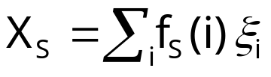
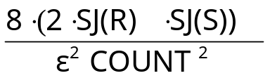



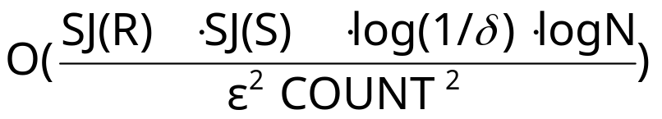
Summary of Binary-Join AMS Sketching
Step 1: Compute random variables: and
Step 2: Define X= X_{R}X_{S}
Steps 3 & 4: Average independent copies of X; Return median of averages
Main Theorem (AGMS99): Sketching approximates COUNT to within a relative error of with probability using space
  Remember: O(log N) space for “seeding” the construction of each X
copies
x
x
x
Average
y
2log(1/ )
copies
x
x
x
Average
y
median
x
x
x
Average
y

Slide 102
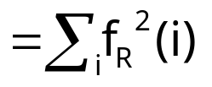
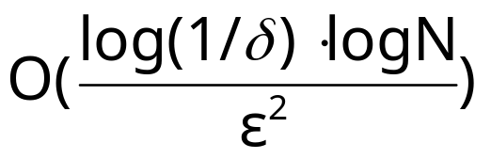
A Special Case: Self-join Size
Estimate COUNT(R A R) (original AMS paper)
Second (L2) moment of data distribution, Gini index of heterogeneity, measure of skew in the data
In this case, COUNT = SJ(R), so we get an (ε,δ)−estimate using space only
Best-case for AMS streaming join-size estimation

Slide 103

Distinct Value Estimation
Problem: Find the number of distinct values in a stream of values with domain [0,...,N-1]
  Zeroth frequency moment , L0 (Hamming) stream norm
  Statistics: number of species or classes in a population
  Important for query optimizers
  Network monitoring: distinct destination IP addresses, source/destination pairs, requested URLs, etc.
Example (N=64)
Data stream: 3 0 5 3 0 1 7 5 1 0 3 7
Number of distinct values: 5

Slide 104
Hash (aka FM) Sketches for Distinct Value Estimation [FM85]
Assume a hash function h(x) that maps incoming values x in [0,…, N-1] uniformly across [0,…, 2^L-1], where L = O(logN)
Let lsb(y) denote the position of the least-significant 1 bit in the binary representation of y
  A value x is mapped to lsb(h(x))
Maintain Hash Sketch = BITMAP array of L bits, initialized to 0
  For each incoming value x, set BITMAP[ lsb(h(x)) ] = 1
BITMAP
5 4 3 2 1 0
x = 5
h(x) = 101100
lsb(h(x)) = 2
0
0
0
1
0
0

Slide 105
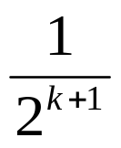

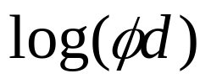

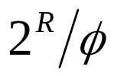
Hash (aka FM) Sketches for Distinct Value Estimation [FM85]
By uniformity through h(x): Prob[ BITMAP[k]=1 ] = Prob[ ] =
  Assuming d distinct values: expect d/2 to map to BITMAP[0] , d/4 to map to BITMAP[1], . . .
Let R = position of rightmost zero in BITMAP
  Use as indicator of log(d)
[FM85] prove that E[R] = , where
  Estimate d =
  Average several iid instances (different hash functions) to reduce estimator variance
BITMAP
L-1
0
0
0
0
0
0
0
1
0
1
0
1
1
1
1
1
1
1
1
fringe of 0/1s around log(d)
position >> log(d)
position << log(d)

Slide 106



Hash Sketches for Distinct Value Estimation
[FM85] assume “ideal” hash functions h(x) (N-wise independence)
  [AMS96]: pairwise independence is sufficient
    h(x) = , where a, b are random binary vectors in [0,…,2^L-1]
  Small-space estimates for distinct values proposed based on FM ideas
Delete-Proof: Just use counters instead of bits in the sketch locations
  +1 for inserts, -1 for deletes
Composable: Component-wise OR/add distributed sketches together
  Estimate |S1 S2 … Sk| = set-union cardinality

Slide 107
The CountMin (CM) Sketch
Simple sketch idea, can be used for point queries, range queries, quantiles, join size estimation
Model input at each node as a vector x_{i} of dimension N, where N is large
Creates a small summary as an array of w ╳ d in size
Use d hash functions to map vector entries to [1..w]
W
d

Slide 108
Bloom Filter

Slide 109
Introduction
Approximate set membership problem .
Trade-off between the space and the false positive probability .
Generalize the hashing ideas.

Slide 110
Approximate set membership problem
Suppose we have a set
S = {s₁,s₂,...,s_{m}} ⊆ universe U
Represent S in such a way we can quickly answer “Is x an element of S ?”
To take as little space as possible ,we allow false positive (i.e. x∉S , but we answer yes )
If x∈S , we must answer yes .

Slide 111
Bloom filters
Consist of an arrays A[n] of n bits (space) , and k independent random hash functions
h₁,…,h_{k} : U --> {0,1,..,n-1}
1. Initially set the array to 0
2. ∀ s∈S, A[h_{i}(s)] = 1 for 1≤ i ≤ k
(an entry can be set to 1 multiple times, only the first times has an effect )
3. To check if x∈S , we check whether all location A[h_{i}(x)] for 1≤ i ≤ k are set to 1
If not, clearly x∉S.
If all A[h_{i}(x)] are set to 1 ,we assume x∈S

Slide 112
x₁
y
y
x₂
0
0
1
1
1
1
1
0
1
1
0
0
1
1
1
0
1
0
0
0
1
1
0
0
1
1
0
Initial with all 0
Each element of S is hashed k times
Each hash location set to 1
To check if y is in S, check the k hash
location. If a 0 appears , y is not in S
If only 1s appear, conclude that y is in S
This may yield false positive

Slide 113

The probability of a false positive
We assume the hash function are random.
After all the elements of S are hashed into the bloom filters ,the probability that a specific bit is still 0 is

Slide 114

To simplify the analysis ,we can assume a fraction p of the entries are still 0 after all the elements of S are hashed into bloom filters.
In fact,let X be the random variable of number of those 0 positions. By Chernoff bound
It implies X/n will be very close to p with a very high probability

Slide 115


The probability of a false positive f is
To find the optimal k to minimize f .
Minimize f iff minimize g=ln(f)
k=ln(2)*(n/m)
f = (1/2)^{k} = (0.6185..)^{n/m}
The false positive probability falls exponentially in n/m ,the number bits used per item !!

Slide 116
Conclusion
A Bloom filters is like a hash table ,and simply uses one bit to keep track whether an item hashed to the location.
If k=1 , it’s equivalent to a hashing based fingerprint system.
If n=cm for small constant c,such as c=8 ,then k=5 or 6 ,the false positive probability is just over 2% .
It’s interesting that when k is optimal
k=ln(2)*(n/m) , then p= 1/2.
An optimized Bloom filters looks like a random bit-string

